Slide 1

CSE4227 Digital Image Processing
Lecture 04 – Pixel and their Relationships
Dr. Kazi A Kalpoma
Professor, Department of CSE
& Director of ICT
Ahsanullah University of Science & Technology (AUST)
Contact: kalpoma@aust.com
Google Class code: q7y5agh
CSE | AUST
Fall 2021

Slide 2
Today’s Contents
Some Basics Relationships between Pixels
    Neighborhood
    Adjacency
    Connectivity
    Paths
    Regions and boundaries
Chapter 2 from R.C. Gonzalez and R.E. Woods, Digital Image Processing (3rd Edition), Prentice Hall, 2008 [ Section 2.5 ] [Problems: 2.9 ~ 2.17 excluding 2.14]
https://www.quora.com/How-can-we-find-the-shortest-m-connected-path-if-the-pixel-values-are-given-in-matrix-form
http://www.cse.iitm.ac.in/~vplab/courses/CV_DIP/PDF/NEIGH_CONN.pdf

Slide 3
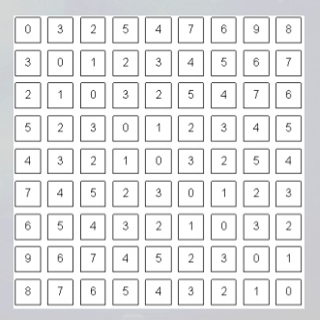
Some Basic Relationships between Pixels

Slide 4
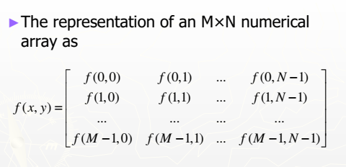
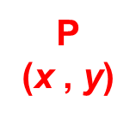
Conventional indexing method of Pixels
(0,0)
x
(x-1,y-1)
(x,y-1)
(x+1,y-1)
y
(x-1,y)
P
(x , y)
(x+1,y)
(x-1,y+1)
(x,y+1)
(x+1,y+1)
Conventional indexing method

Slide 5

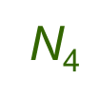
Pixel and their Relationships
Neighbors of a pixel, p(x,y)
Neighborhood relation is used to tell adjacent pixels.
It is useful for analyzing regions.
3 types of neighbors
  N₄(p): 4-neighbor of p
  N_{D}(p): diagonal neighbor of p
  N₈(p): 8-neighbor of p
P

Slide 6
N₄(p): 4-neighbor of p
q
considers only vertical and horizontal neighbors pixels.
Note: q ∈ N₄(p) implies p ∈ N₄(q)
q
P
q
q
4-neighbors of p(x,y):
(x,y-1)
(x−1,y)
(x+1,y)
(x,y−1)
(x,y+1)
(x-1,y)
P
(x,y)
(x+1,y)
N₄(p) =
(x,y+1)
Each of them is at a unit distance from P.

Slide 7
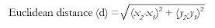
N_{D}(p): diagonal neighbor of p
q
q
considers only diagonal neighbors pixels.
Note: q ∈ N_{D}(p) implies p ∈ N_{D}(q)
P
q
q
Diagonal neighbors of p(x,y):
(x-1,y-1)
(x+1,y-1)
(x−1,y−1)
(x+1,y−1)
(x−1,y+1)
(x+1,y+1)
p
N_{D}(p) =
(x-1,y+1)
(x+1,y+1)
Each of them are at Euclidean distance of 1.414 from P.

Slide 8
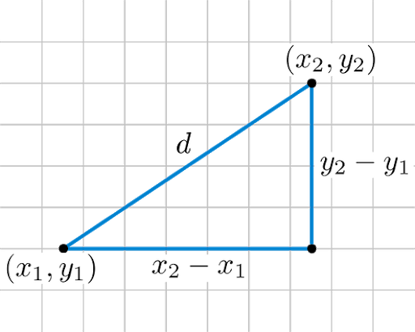
Euclidean distance

Slide 9
N₈(p): 8-neighbor of p
q
q
q
considers all neighbors pixels.
Note: q ∈ N₈(p) implies p ∈ N₈(q)
q
P
q
q
q
q
8-neighbors of p(x,y):
(x-1,y-1)
(x,y-1)
(x+1,y-1)
(x−1,y−1)
(x,y−1)
(x+1,y−1)
(x−1,y)
(x+1,y)
(x−1,y+1)
(x,y+1)
(x+1,y+1)
(x-1,y)
p
(x+1,y)
N₈(p) =
(x-1,y+1)
(x,y+1)
(x+1,y+1)

Slide 10
Missing neighbors!
Some of the points in the N₄, N_{D} and N₈ may fall outside image when P lies on the border of image.
  Discard
  Zero padding
  Pixel replication
a (x,y) | b | c | d | e
f |  |  |  | j
k |  |  |  | o
p |  |  |  | t
u | v | w | x | y

Slide 11
Pixel Adjacencies
Adjacencies depends on both
  neighborhood
  Pixel gray values
Two pixels are connected if they are neighbors and their gray levels satisfy some specified criterion of similarity.
For example, in a binary image two pixels are connected if they are 4-neighbors and have same gray value (0/1).

Slide 12
Pixel Adjacencies
Let V be the set of intensity values
V =
Adjacent pixels must be neighbors and have gray values from the same set, V
In binary image, V = {1} if we are referring to adjacency of pixels with value 1
In gray-scale image, V can be any subset of 256 values

Slide 13
Pixel Adjacencies
3 types of adjacencies
  4-adjacency
  8-adjacency
  m-adjacency

Slide 14
Pixel Adjacencies
4-adjacency
  Two pixels p, q are 4-adjacent if
    q is in the set N₄(p)
    p, q have values from set V,
    (V be the set of intensity values )
P
N₄(p)
V =
p
q
Here, p and q are 4-adjacent and connected
But p and r not 4-adjacent pixels and not connected,
r is not from set V.
r

Slide 15
Pixel Adjacencies
8-adjacency
  Two pixels p, q are 8-adjacent if
    q is in the set N₈(p)
    p, q have values from set V,
    (V be the set of intensity values)
P
N₈(p)
q
r
V =
p
Here, p and q are 8-adjacent and connected
But p and r not 8-adjacent pixels and not connected,
r is not from set V.

Slide 16
Pixel Adjacencies
m-adjacency
  Two pixels p, q are m-adjacent iff
  p, q have values from set V, and
    q in N₄(p), or
    q in N_{D}(p) and has no pixel with value from V
V =
q
t
p
s
p, q are not m-adjacency pixels
s, t are m-adjacency pixels

Slide 17
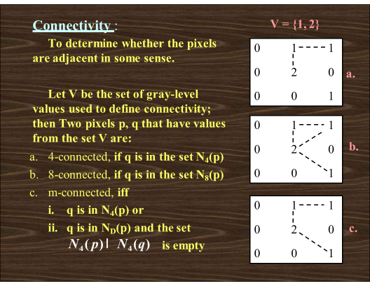

Slide 18
A digital path
A digital path from pixel p with coordinates (x,y) to pixel q with coordinates (s,t) is a sequence of distinct pixels with coordinates (x0,y0), (x1,y1), …, (xn,yn),
  where
  (x0,y0)= (x,y) and (xn,yn)=(s,t),
  and pixels (xi,yi) and (xi-1,yi-1) are adjacent for 1 ≤ i ≤ n.
n is the length of the path
If (x₀,y₀) = (x_{n}, y_{n}), the path is closed.
We can specify 4-, 8- or m-paths depending on the type of adjacency specified.

Slide 19
A Digital Path
Look for a path from p to q:
When, V =
8-path
m-path
p
p
p
q
q
q
4-path from p to q not possible
m-path from p to q
solves this ambiguity
8-path from p to q
results in some ambiguity

Slide 20
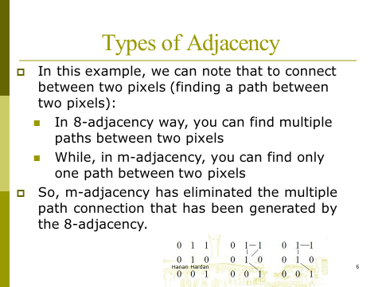
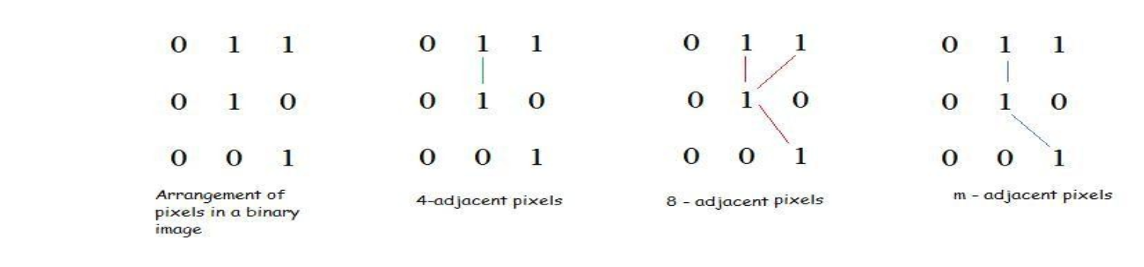

Slide 21
Example of m-connected path:
Find out the m-connected path between p and q, with V={1, 2} from the following image matrix.
Is 4-connected path between p and q possible?
The m-connected path between p and q is:
    2(p) -> 1 -> 2 -> 2 -> 1 -> 2(q)
4 | 2 | 3 | 2(q)
3 | 3 | 1 | 3
2 | 3 | 2 | 2
2(p) | 1 | 2 | 3

Slide 22
Adjacency / Connectivity
Let S represent a subset of pixels in an image,
  Two pixels p and q are connected in S if there is a path between p and q entirely in S
Two image subsets S1 and S2 are adjacent if some pixel in S1 is adjacent to some pixel in S2
p
S₁
S₂
S
q

Slide 23
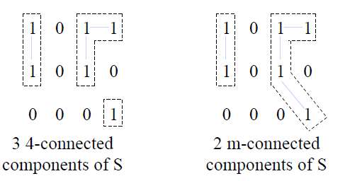
Connected Component
Connected Component in a set of pixels, S
  For any pixel p in S, the set of pixels that are connected to it in S is called a connected component of S

Slide 24
Definition of Region
Connected Set, S
  If all pixels of S are connected to p
p
p
S
q
Region
  If it only has one connected component,
      then set S is called a connected set.
      And we call S a region of the image R
Region is a Connected Set

Slide 25
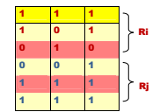
Region that are not adjacent are said to be disjoint.
Example: the two regions (of 1s) in figure, are adjacent only if 8-adjacany is used.
4-path between the two regions does not exist, (so their union is not a 4-connected set).
V = {1}

Slide 26
Boundary of a region
Boundary of a region, R
  Set of pixels whose at least one neighbor is not in R
  also called border or contour) of a region R
Boundary or contour
a | b | c | d | e
f |  |  |  | j
k |  |  |  | o
p |  |  |  | t
u | v | w | x | y
If R happens to be an entire image, then its boundary is defined as the set of pixels in the first and last rows and columns in the image.

Slide 27
Distance Metrics
If we have 3 pixels: p,q,z respectively
p with (x,y)
q with (s,t)
z with (v,w)
D, distance function has following properties:
  D(p,q) ≥ 0 [D(p,q) = 0 iff p = q] and
  D(p,q) = D(q,p) and
  D(p,z) ≤ D(p,q) + D(q,z)

Slide 28
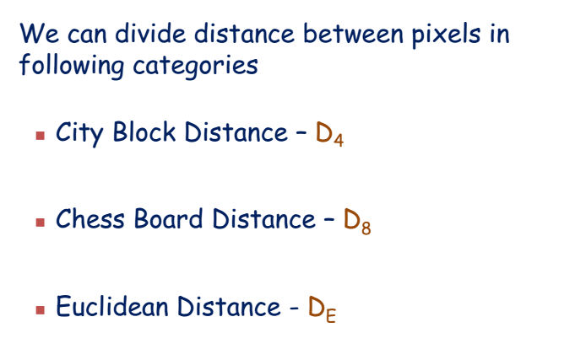
Distance Metrics

Slide 29

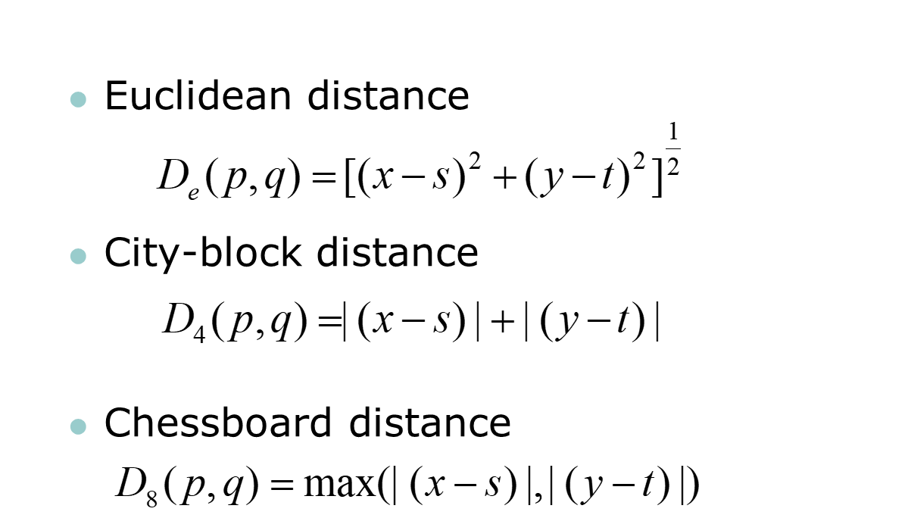
p with (x,y)
q with (s,t)

Slide 30
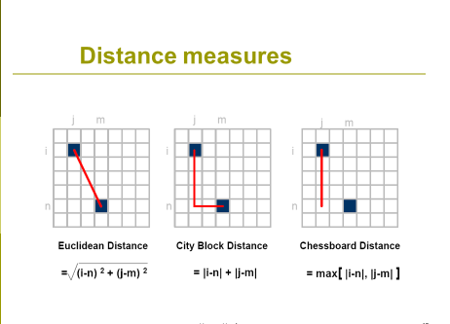

Slide 31
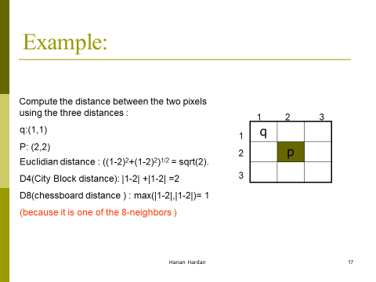

Slide 32
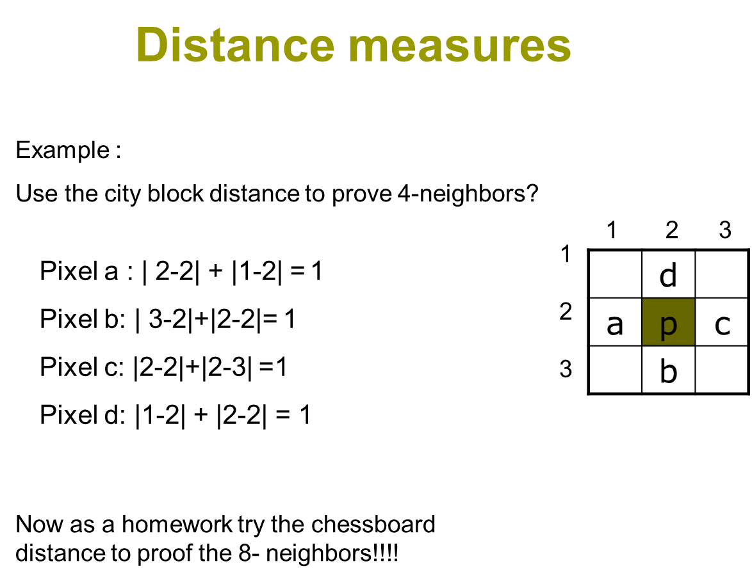

Slide 33
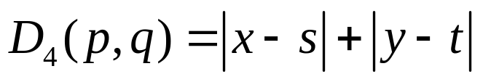
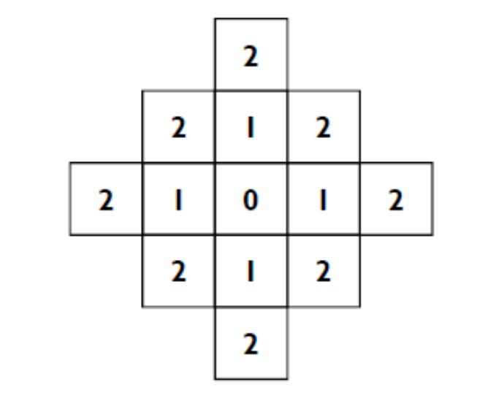
City block distance (D4 distance)
The pixels with distance D4 ≤ 2 from (x,y) form the following contours of constant distance, diamond with center at (x,y)
D₄ = 1 are the 4 neighbors
of pixel p(x,y)

Slide 34
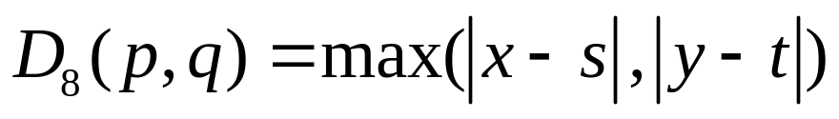
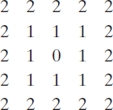
Chessboard distance (D8 distance)
D8 distance ≤ 2 from (x,y) form the following contours of constant distance, square centered at p(x,y)
D₈ = 1 are the 8 neighbors
of pixel p(x,y)

Slide 35
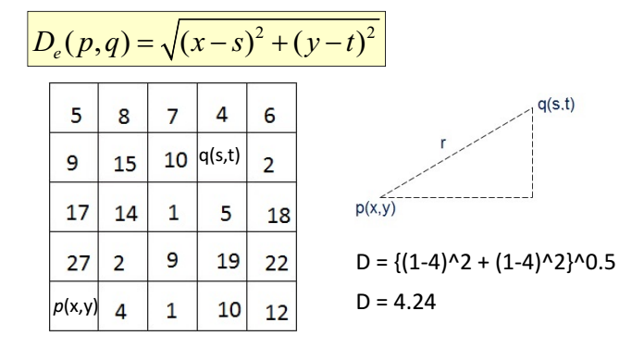
Euclidean Distance
A circle with radius r centered at (x,y)

Slide 36
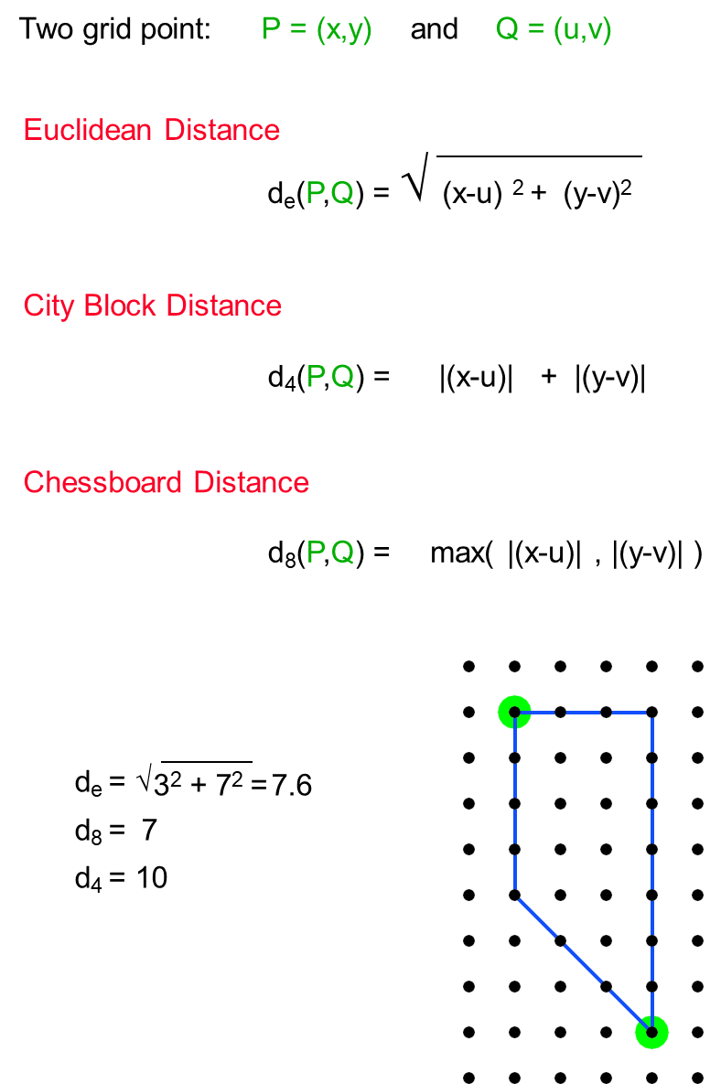

Slide 37
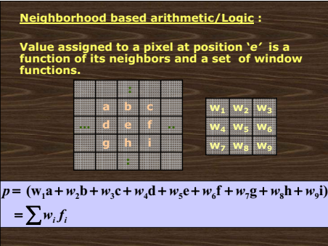

Slide 38
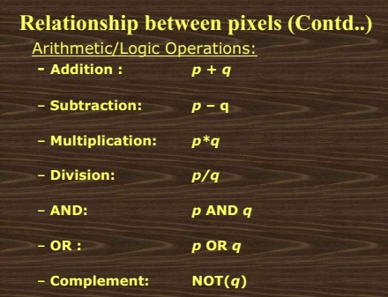

Slide 39
Arithmetic/Logic Operations
Tasks done using neighborhood processing:
  Smoothing / averaging
  Noise removal / filtering
  Edge detection
  Contrast enhancement

